Slide 1
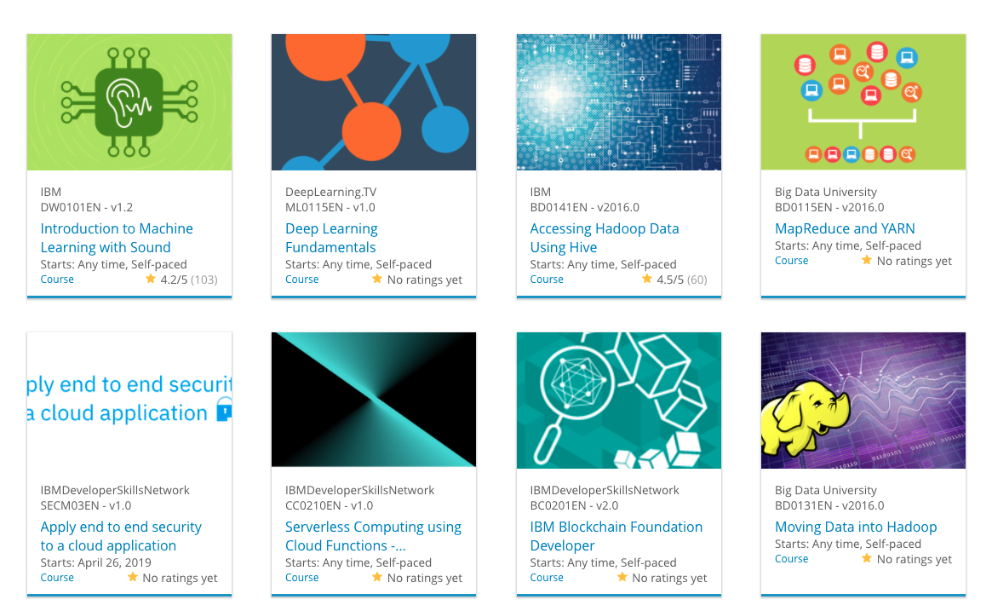

Build a Personalized Online Course Recommender System with Machine Learning
Faheemuddin Sayyed
18.12.2024

Slide 2

Outline
Introduction and Background
Exploratory Data Analysis
Content-based Recommender System using Unsupervised Learning
Collaborative-filtering based Recommender System using Supervised learning
Conclusion
Appendix

Slide 3
Introduction
• Project Overview:
The goal of this capstone project is to build a personalized course recommender system for an online learning platform. This system utilizes multiple machine learning techniques to deliver customized recommendations based on user preferences and course content.
• Objectives:
1. Understand user preferences and course attributes.
2. Implement different types of recommender systems:
• Content-based filtering using user profiles and course genres.
• Collaborative filtering (KNN, NMF, and neural networks).
• Hybrid approaches for better recommendations.
3. Evaluate the performance of these models.
• Why Personalized Recommendations Matter:
Personalized recommendations can:
• Improve user engagement and satisfaction.
• Help users discover relevant courses more efficiently.
• Increase course enrollments on the platform.

Slide 4
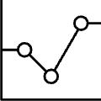
Exploratory Data Analysis

Slide 5
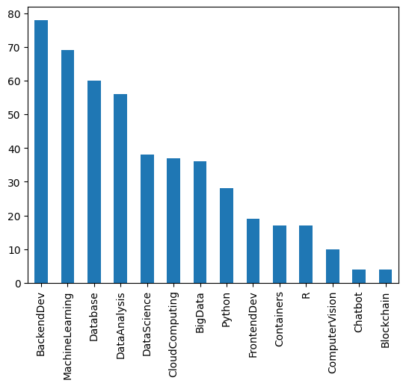
Course counts per genre
The bar chart shows the distribution of courses across various genres. It highlights the most popular genres by their course counts, helping identify the platform's content focus.

Slide 6
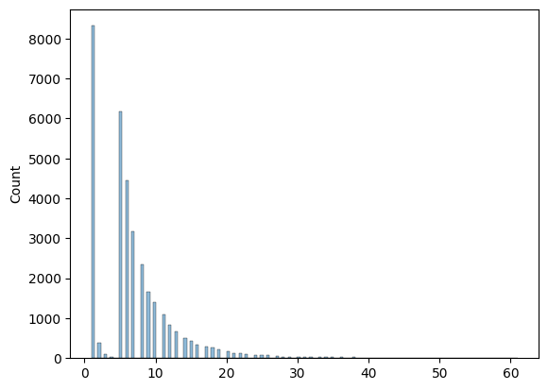
Course enrollment distribution
- The histogram illustrates user engagement, showing enrollment frequency across courses. It identifies trends like courses with the highest or lowest enrollments.

Slide 7
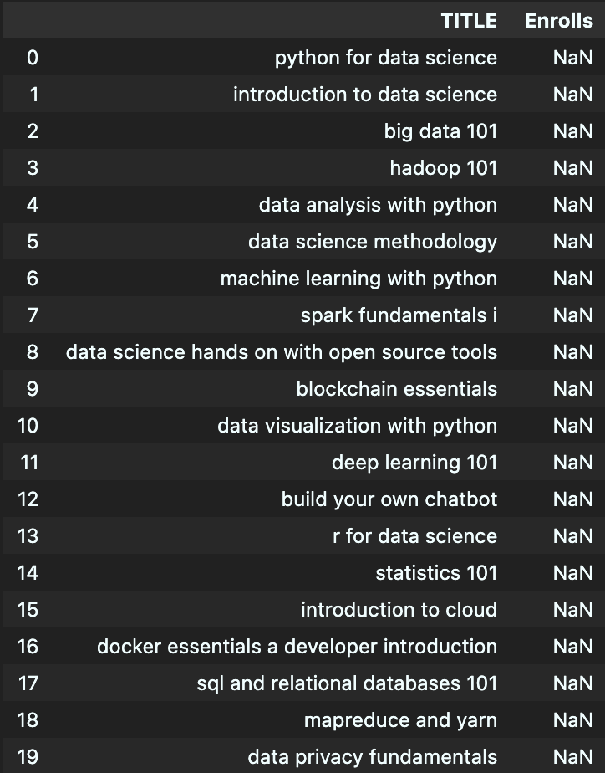
20 most popular courses
This list reflects the platform's top-enrolled courses, giving insight into user preferences and trending topics.

Slide 8
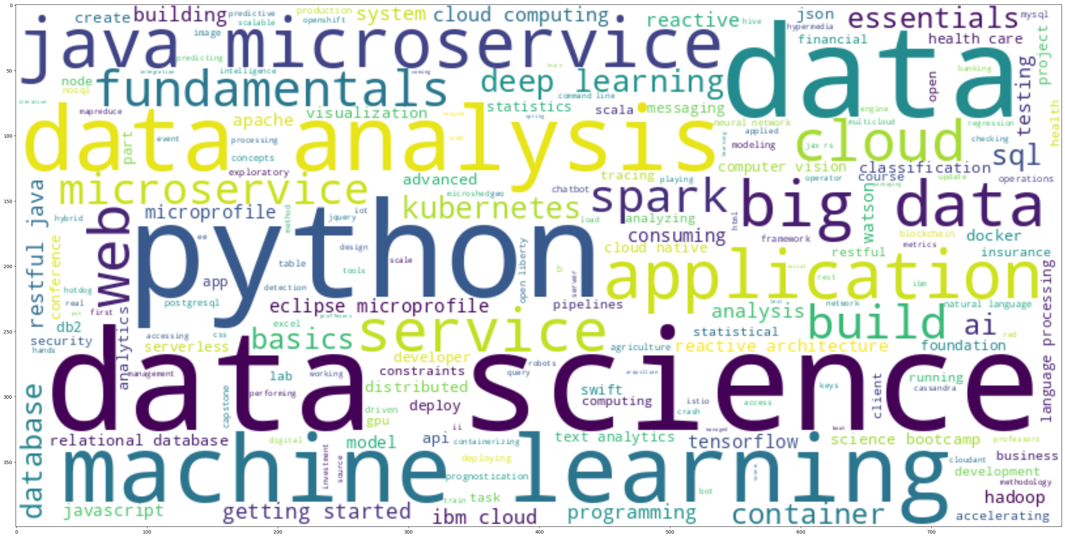
Word cloud of course titles
- The word cloud emphasizes the most common keywords in course titles, showcasing the primary themes and topics offered.

Slide 9
Content-based Recommender System using Unsupervised Learning
Cluster2
Cluster1

Slide 10
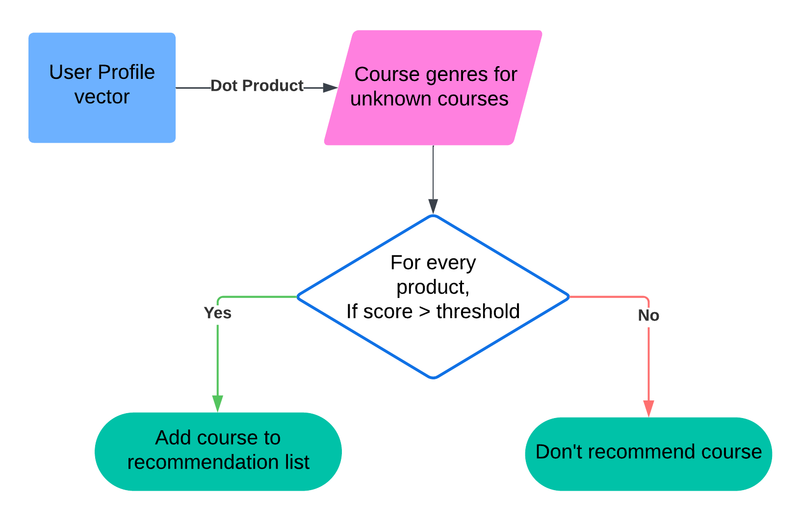
Flowchart of content-based recommender system using user profile and course genres
- Illustrates the process of constructing user vectors from their profiles and matching them with course genre vectors to recommend content.

Slide 11
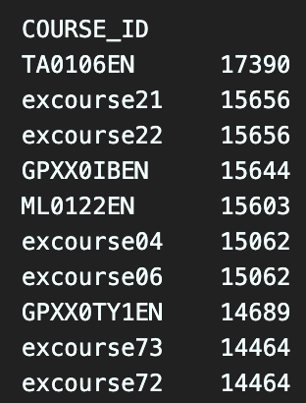
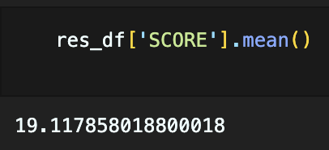
Evaluation results of user profile-based recommender system
Hyperparameters tuned:
score_threshold = 10
On average, how many new/unseen courses have been recommended per user (in the test user dataset)
What are the most frequently recommended courses? Return the top-10 commonly recommended courses across all users

Slide 12
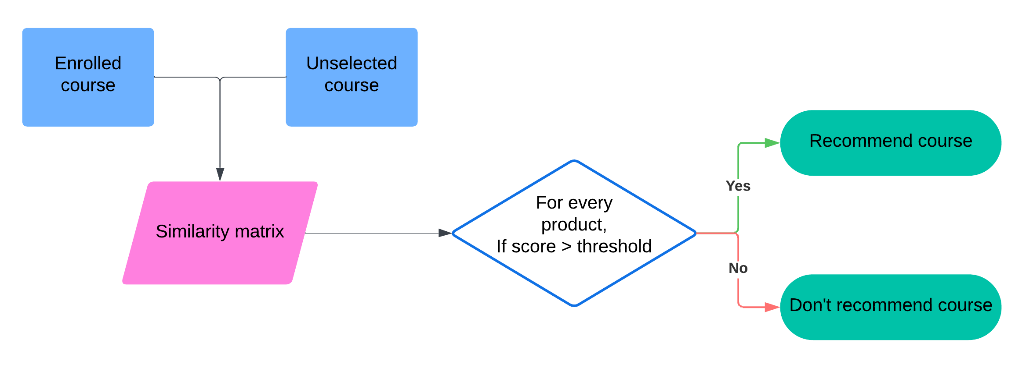
Flowchart of content-based recommender system using course similarity
- Describes the methodology for calculating similarity between courses and generating recommendations for users based on their history.

Slide 13
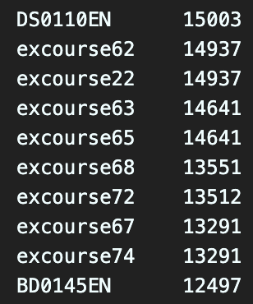
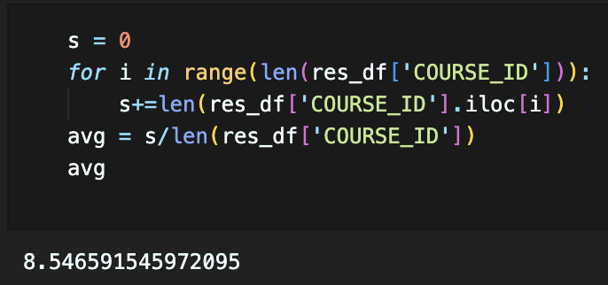
Evaluation results of course similarity based recommender system
Hyperparameters tuned:
threshold = 0.6
On average, how many new/unseen courses have been recommended per user (in the test user dataset)
What are the most frequently recommended courses? Return the top-10 commonly recommended courses

Slide 14
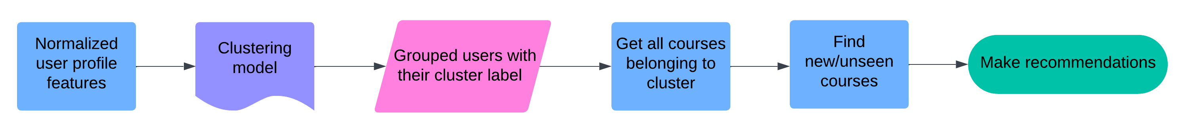
Flowchart of clustering-based recommender system
- Demonstrates clustering user profiles into segments to deliver group-based recommendations.

Slide 15
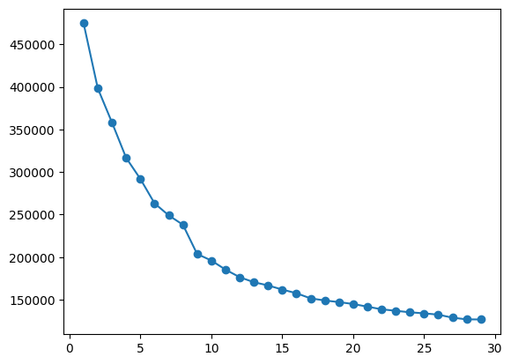
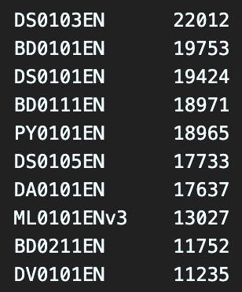
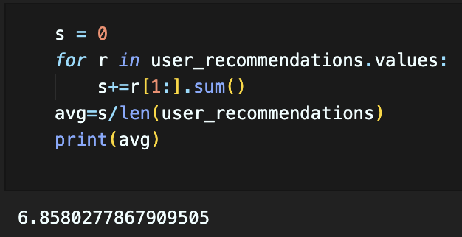
Evaluation results of clustering-based recommender system
Hyperparameters tuned:
n_clusters = 20
What are the most frequently recommended courses? Return the top-10 commonly recommended courses
n_clusters vs sum of squared distances
On average, how many new/unseen courses have been recommended per user (in the test user dataset)

Slide 16
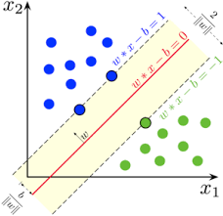
Collaborative-filtering Recommender System using Supervised Learning

Slide 17
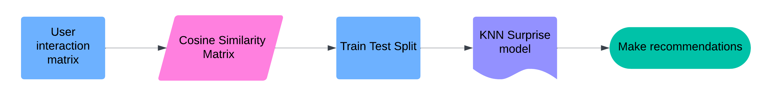
Flowchart of KNN based recommender system
- Explains the implementation of KNN using historical user-course interactions to generate recommendations.

Slide 18
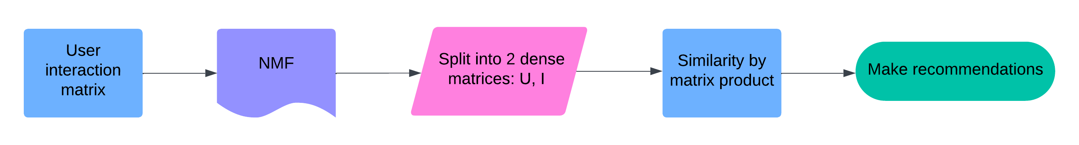
Flowchart of NMF based recommender system
- Visualizes how NMF decomposes the user-course matrix to predict missing values and generate personalized suggestions.

Slide 19
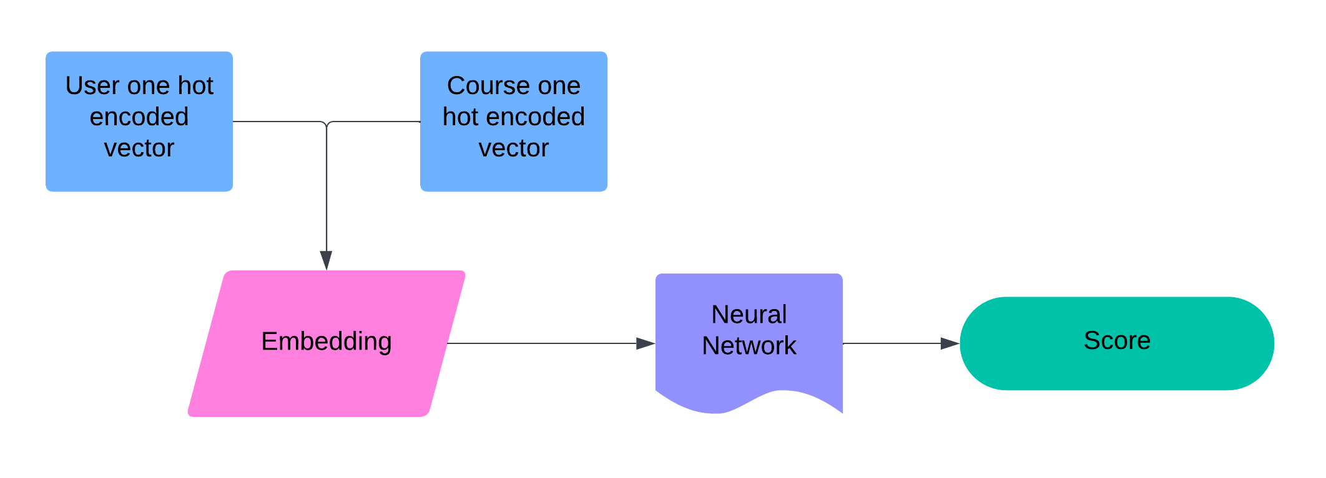
Flowchart of Neural Network Embedding based recommender system
- Outlines the process of embedding users and courses into a shared space for high-quality recommendations.

Slide 20
Compare the performance of collaborative-filtering models
The bar chart compares the RMSE of various collaborative filtering models, with the neural network model achieving the best performance, followed by NMF and KNN.

Slide 21
Conclusions
Summary: The project successfully demonstrated a personalized course recommendation system using multiple machine learning techniques, enhancing user satisfaction and engagement.
Key Findings:
Content-based models efficiently utilized user preferences and course metadata.
Collaborative filtering methods, especially neural networks, outperformed in prediction accuracy.
Combining diverse approaches ensures robust recommendations.

Slide 22
Additional Insights
Hybrid Recommendations: Exploring combining content-based and collaborative filtering for improved accuracy and diversity in recommendations.
Explainable Recommendations: Implementing feature to show users why a course was recommended, increasing trust and engagement.
Real-Time Recommendations: Introducing models capable of updating recommendations dynamically based on user activity.
Enhanced Evaluation Metrics: Beyond RMSE, considering user engagement metrics like click-through rates and completion rates for holistic model assessment.

Slide 23
Appendix
GitHub Repo Link:
https://github.com/Faheem219/IBM-Machine-Learning-Codes

